Slide 1
Gossip Protocol

Slide 2
Problems
Broadcast or multicast a message to all nodes in the network simultaneously.
Each node does not send the message to all nodes, but each node sends the message to only a few of the nodes.

Slide 3
Usage
Redis
Cluster membership
Cassandra and DynamoDB
Bit Torrent
Consul
Failure Detection
Overlay networks and aggregations

Slide 4
From Epidemiology to Distributed Systems
Disease spread quickly and robustly.
Our goal is to spread an update as fast and reliable as possible.
Can we apply these ideas to the distributed systems?

Slide 5
Protocol
A node wants to send a message to all nodes in the network.
Periodically, it selects randomly a node from the set of nodes and sends the message.
Any nodes received the message repeat the same process.
The message is periodically sent to N targets (fanout).
Cycle: number of rounds to spread a rumour.
Fanout: number of nodes gossip in each cycle.
With fanout = 1, you need O(log N) cycles to reach all nodes.

Slide 6
3 Stages in Gossip
Susceptible: Node “n” is not yet infected by the disease.
Infective: Node “n” is infected and capable to spread the disease.
Removed: Node “n” has been infected and has recovered from the disease.
Susceptible: Node “n” has not yet received an update.
Infective: Node “n” has received an update and is now ready to forward the update.
Removed: Node “n” has the update but is no longer willing to share it.

Slide 7
What is Entropy?
What is Anti-Entropy?
Entropy is a measure of randomness.
Before a message exchange, sender does not know anything about receiver, but both have some random information.
After the message exchange, both sender and receiver will have exactly the same information.
The above message change reduces randomness in information.

Slide 8
2-Style of Epidemic Protocols
Anti-entropy
Each Node “n” periodically contacts a random peer “p” selected from the pool.
Then, n-p engages in an information exchange protocol: n to p (push), n from p (pull), or both push-pull.

Slide 9
2-Style of Epidemic Protocols
Rumor mongering
Nodes are initially ignorant.
When an update is received by a node, it becomes a hot rumor.
While a node holds a hot rumor, it periodically chooses a random peer from the pool and sends (push) the rumor to it.
Eventually, a node will lose interest in spreading the rumor.

Slide 10
Gossip Protocol
Each node in the system periodically exchanges information with a subset of nodes selected randomly.
Complete membership table is unrealistic in a large scale dynamic cluster.
Instead, each node maintains a small local membership table that provides a partial view on the complete set of nodes.
Periodically refreshes the table using a gossiping procedure.

Slide 11
Peer Selection
Uniform Random
Highest Age

Slide 12
Data Propagation
Push
Push-pull

Slide 13
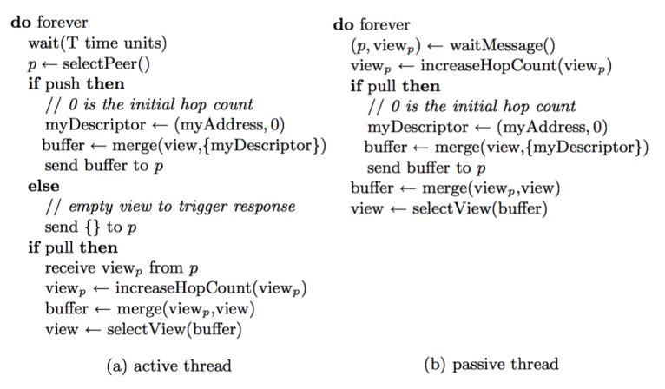
Pseudo Code

